Slide 1
CSCI U511 01 Operating Systems AKM Jahangir A Majumder, PhD
Fall 2019 - Lecture 4
Sept. 3, 2019
Note: Some slides are adapted from those used by previous instructors and some slides include figures from the textbook.

Slide 2
Review and Learning Outcomes
We start to discuss Chap 2: Kernels and Abstraction
We will discuss Processes and Threads today
Kernels Abstraction
Interrupts
Upcalls
We will have our first quiz on Thursday, September 5 which will cover lectures 1-3
HW 1 is due today
HW 1 key will post on Blackboard soon
We will discuss rest of the project proposal today
Please send me your updated proposal soon

Slide 3
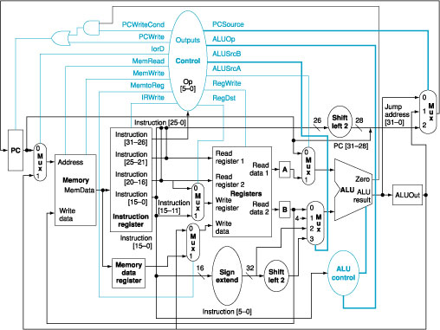
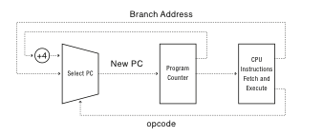
Review: A Model of a CPU
The basic operation of a CPU, Opcode, is the decoded instruction to be executed

Slide 4
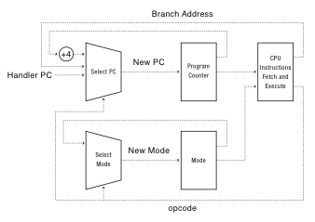
A CPU with Dual-Mode Operation
The Operation of a CPU with kernel and user modes
Notes:
Where do interrupts fit in?

Slide 5
Hardware Support: Dual-Mode Operation
Privileged instructions
Available to kernel
Not available to user code
Limits on memory accesses
To prevent user code from overwriting the kernel
Timer
To regain control from a user program in a loop (Kernel must have a way)
Safe way to switch from user mode to kernel mode, and vice versa

Slide 6
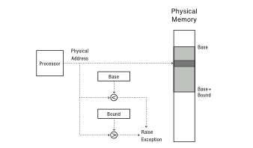
Simple Memory Protection
Two registers, Base (specifies start of memory region) and bound (specifies end of memory) memory protection using physical addresses.
Every code and data address generated by the program is first checked to verify that its address lies within the memory region of the process.
Notes:
Second thing

Slide 7
Towards Virtual Addresses
Problems with base and bounds?
Memory sharing
Physical memory address (starting at zero)
Memory fragmentation (impossible to relocate program)
Notes:
Expandable heap?
Expandable stack?
Memory sharing between processes?
Non-relative addresses – hard to move memory around
Memory fragmentation

Slide 8
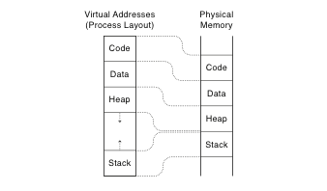
Virtual Addresses
Processors (P) level of indirection. All P’s memory start at the same place
Translation done in hardware, using a table
Table set up by operating system kernel (details will discuss in chapter 8)
Notes:
On every instruction!
Table of instructions set up by the kernel: similar idea to buffer descriptor queue for I/O

Slide 9
Example: Physical Vs. Virtual memory
int staticVar = 0; // a static variable
main() {
staticVar += 1;
sleep(10); // sleep for x seconds
printf ("static address: %x, value: %d\n", &staticVar, staticVar);
}
What if we took the address of a procedure local variable in two copies of the same program running at the same time?
ANS: the output does not change
Notes:
Because of stack address munging on modern systems (to prevent viruses), if you use a procedure local variable, won’t get the same result – different addresses used by different instances

Slide 10
Hardware Timer
Hardware device that periodically interrupts the processor
Returns control to the kernel handler
Interrupt frequency set by the kernel
Not by user code!
Interrupts can be temporarily deferred
Not by user code!
Interrupt deferral crucial for implementing mutual exclusion
Notes:
How do I stop a runaway program? How do I know if a runaway program needs to be stopped, or its just taking a long time?

Slide 11
Mode Switch: User to Kernel
From user mode to kernel mode. Three reasons for the kernel to take control from a user.
Interrupts
Triggered by timer and I/O devices (asynchronous signal)
Exceptions
Triggered by unexpected program behavior
Or malicious behavior!
System calls (aka protected procedure call)
Request by program for kernel to do some operation on its behalf
Only limited # of very carefully coded entry points
Notes:
Might work better starting with interrupts!

Slide 12
Mode Switch: Kernel to User
From kernel mode to user mode
New process/new thread start
Jump to first instruction in program/thread
Kernel copies the program into a memory location
Set PC to 1st instruction and set stack pointer to the baser of user stack
Switches to user mode
Return from interrupt, exception, system call
Resume suspended execution
Process/thread context switch
Resume some other process
User-level upcall (UNIX signal)
Asynchronous notification to user program

Slide 13
How do we take interrupts safely?
Interrupt vector
Limited number of entry points into kernel. User program not allowed to jump into an arbitrary location in the kernel.
Atomic transfer of control
Single instruction to change:
Program counter
Stack pointer
Memory protection
Kernel/user mode
Transparent restartable execution
User program does not know interrupt occurred. The OS must be able to restore the state of the user program as it was before interrupt.

Slide 14
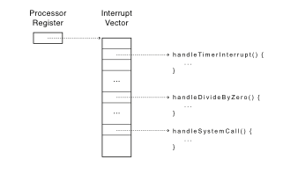
Interrupt Vector
Table set up by OS kernel; pointers to code to run on different events. Lists of kernel routines to handle hardware interrupts, exceptions, and system calls
Notes:
Note: by “processor register” I do not mean %eax. Rather – these are special purpose registers.

Slide 15
Interrupt Stack
Register point to a region of kernel memory
Per-processor, located in kernel (not user) memory
Usually a process/thread has both: kernel and user stack
Why can’t the interrupt handler run on the stack of the interrupted user process?
Reliability
Security
Notes:
What goes in a stack frame?
Frame pointer
Locals
Return address

